Slide 1
Wave-front sensing / control
R&D activities for Space applications
2017 ITHD-II Workshop

Slide 2
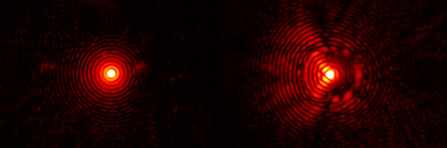
Wave-front control (PhD Lucie Leboulleux)
Light source
Collaboration STScI
Error budget for studying space high contrast sensitivity to aberrations on segmented pupils
  Simplified analytic model for wide exploration
  End-to-End model (COFFEE library) for precise coronagraph modelisation.
Non linear Dark Hole
  Non-linear => 1 shot application
  Model-based technique
    DM, Pupil shapes, Amplitudes effects, Coronagraph (focal + apo)
  Perspectives
    Application on HiCat
    Application on THD (CNES, link to O. Herscovoci PhD)
AO sytem (DM)
φ (voltages)
Coronagraph
Non-linear DH
Science Camera
ψ
WFS (Coffee)
O. Herscovici
L. Leboulleux
Validation on MITHIC

Slide 3
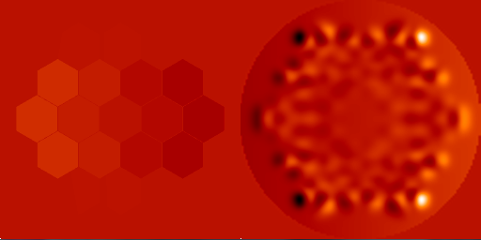
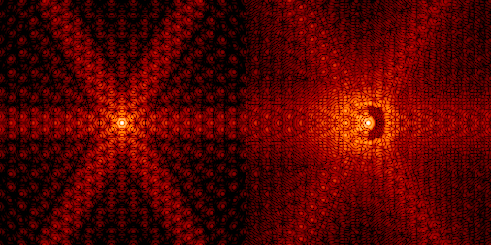
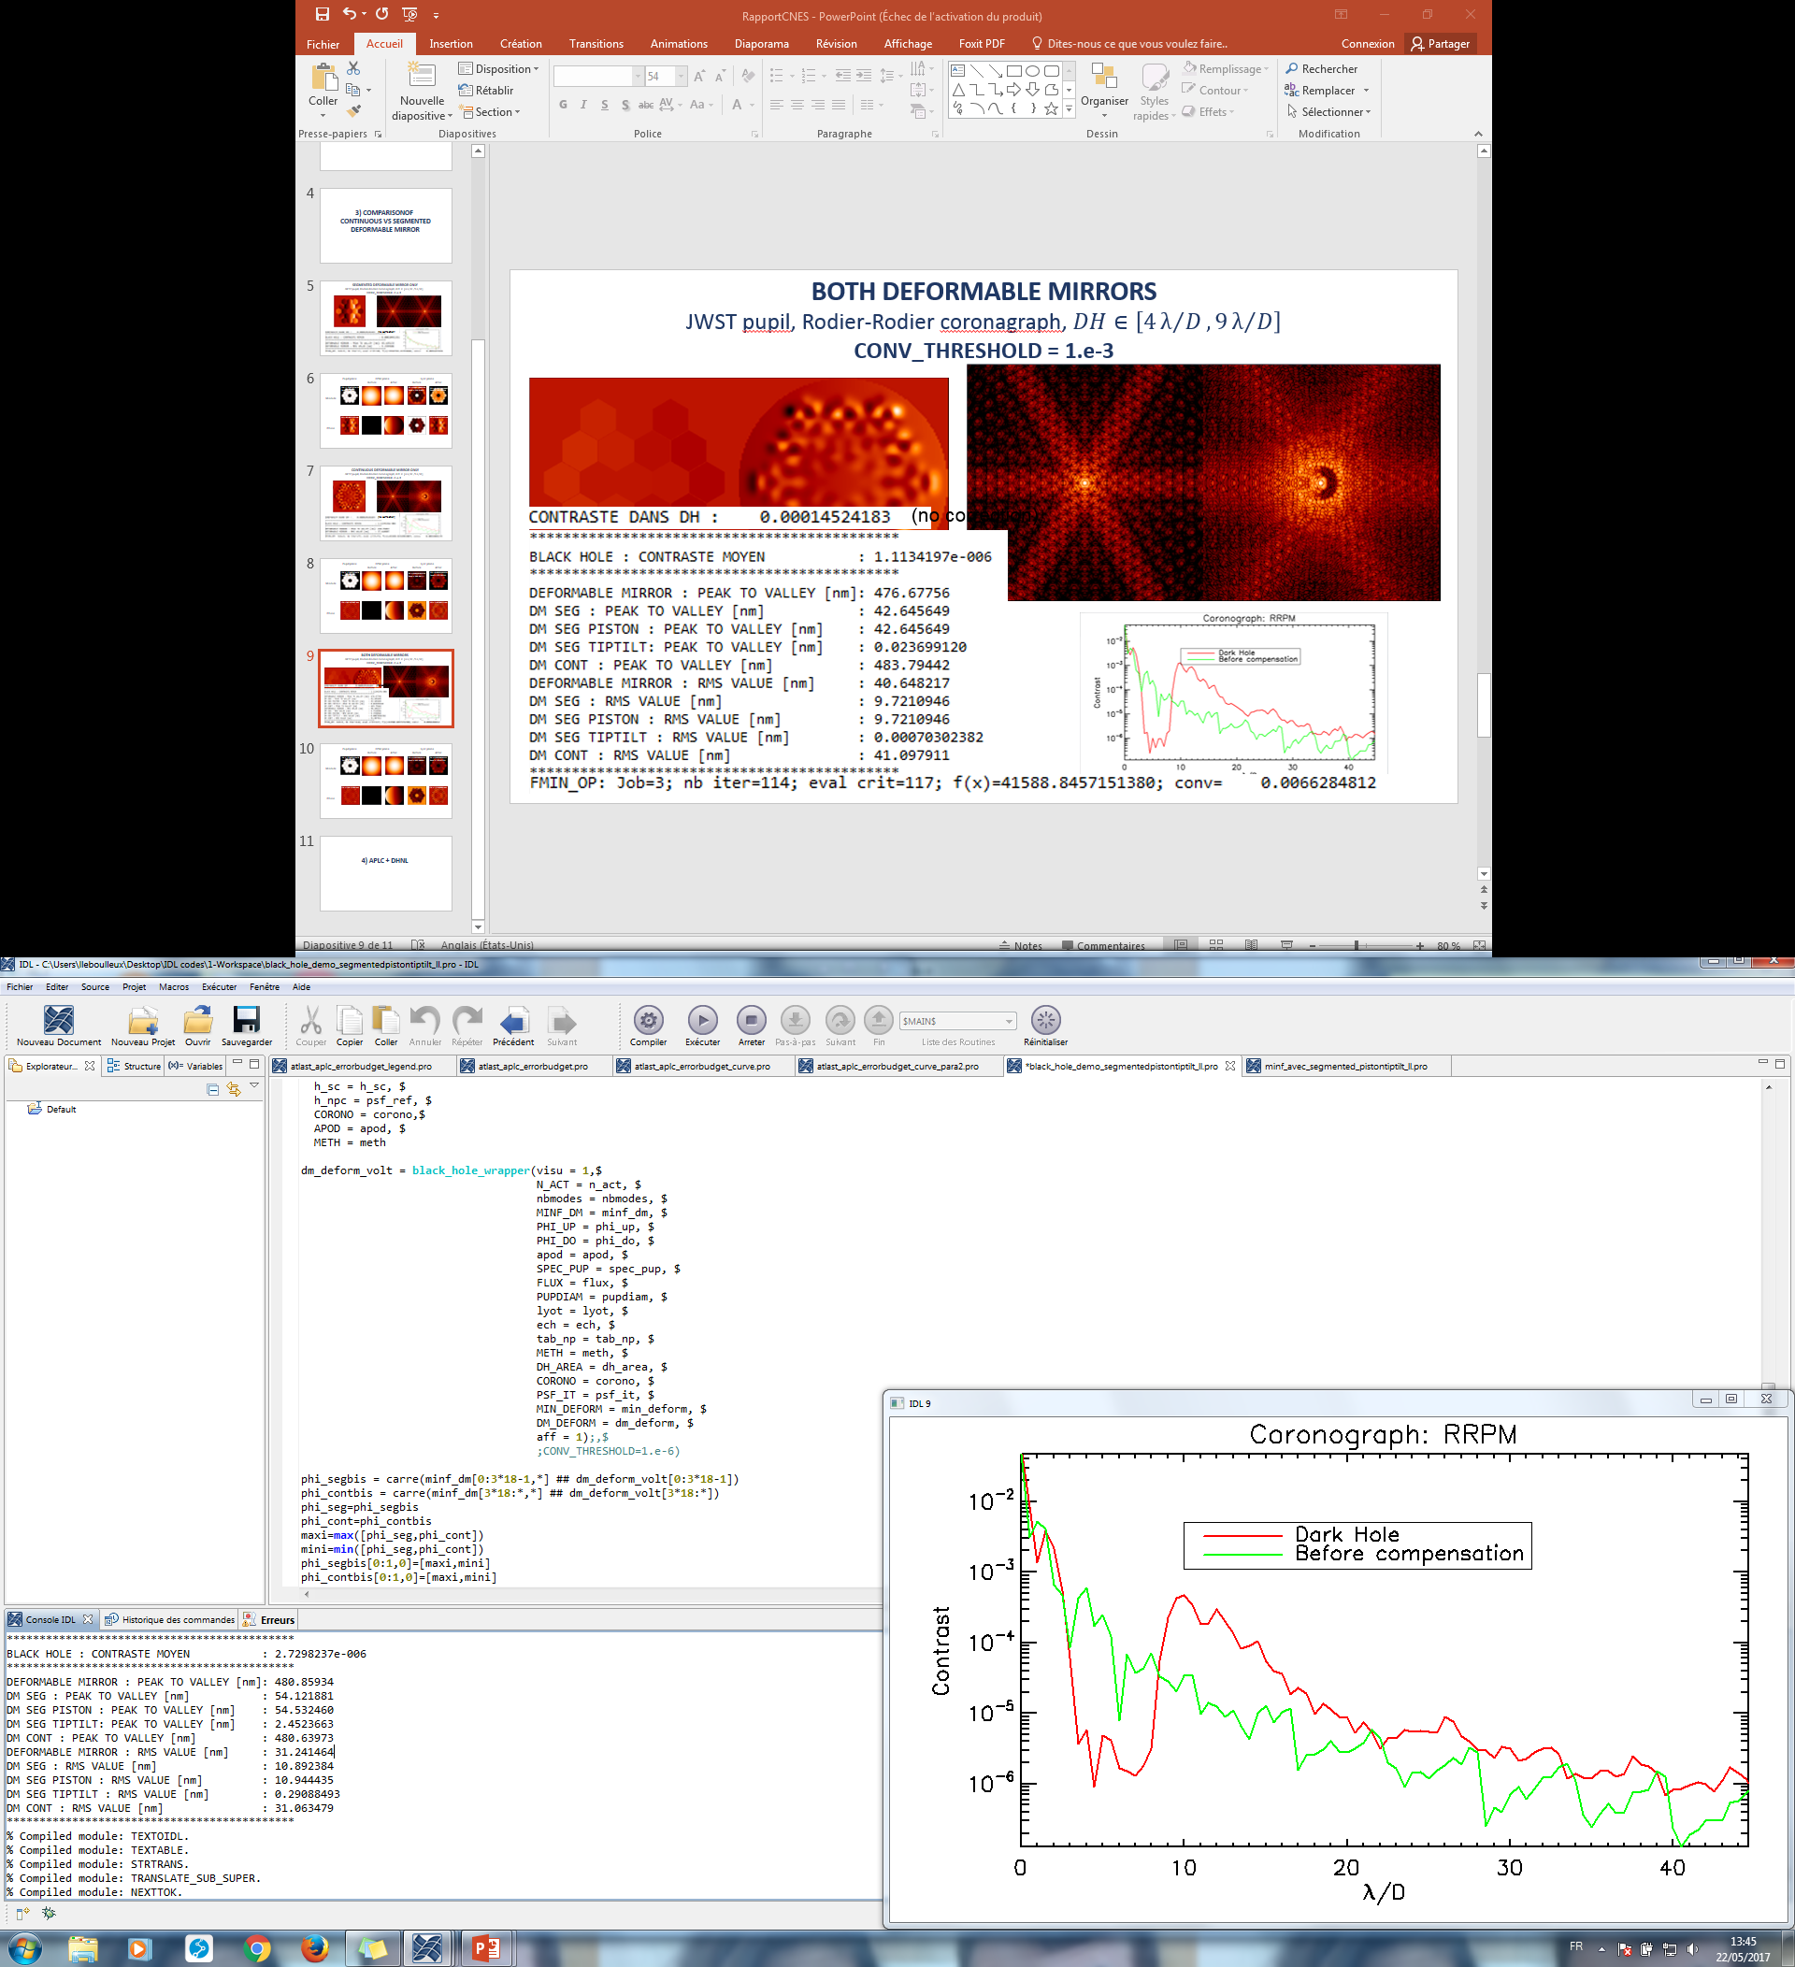
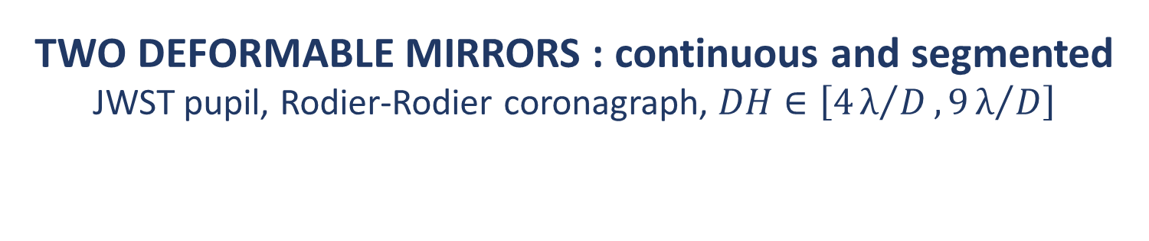
TWO DEFORMABLE MIRRORS : continuous and segmented
JWST pupil, Rodier-Rodier coronagraph, $DH∈\left[4λ/D,9λ/D\right]$

Slide 4
Multi-DM achromatic correction
Problem: Chromatic aberration of the instrument limits the efficiency of coronagraphic instruments (Broadband Spectroscopy)
Purpose: To use multiple DMs to correct residual chromatic aberrations
Current activities (LESIA):
  Theoretical, algorithm aspects and experimental tests on THD2 (collab Netherlands, SRON)
  Dvlpt of efficient components over wide band for testing on THD2

Slide 5
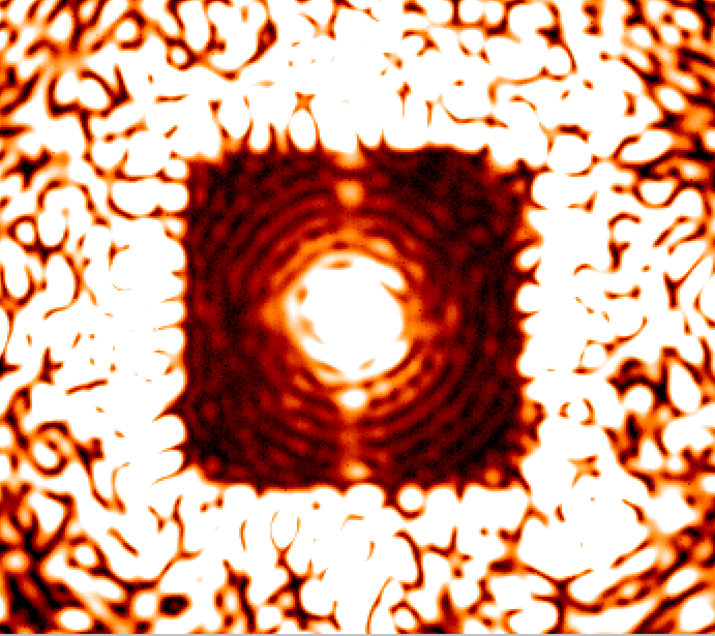
Multi-DM amplitude correction
Problem: Amplitude aberrations of the instrument limits the efficiency of coronagraphic instruments
Purpose: To use multiple DMs to correct amplitude aberrations
Current activities (LESIA):
  Theoretical and algorithm aspects (collab with Nice Obs.)
  Experimental tests on THD2
FDH correction below 3 10⁻⁸ between 5 λ/D and 10 λ/D
(Baudoz et al. in prep)

Slide 6
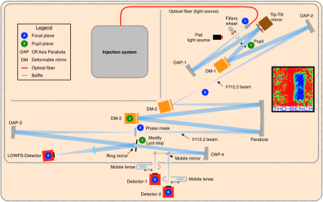
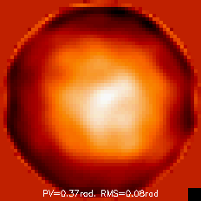
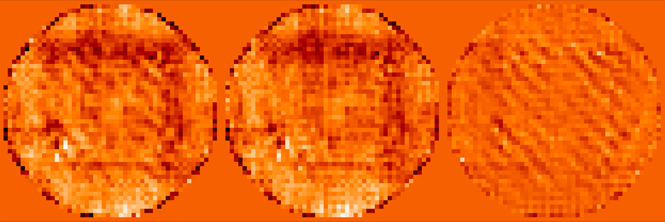
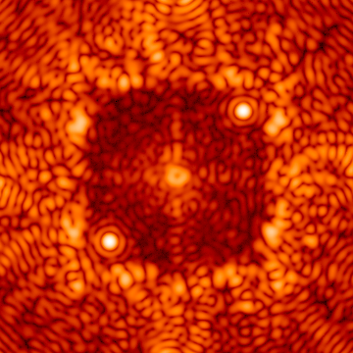
1ère démonstration expérimentale de
“COFFEE complexe”, sur le banc THD
PhD Olivier Herscovici
Recherche aberrations de phase et d'amplitude pour très haut contraste
Collaboration LESIA, financement R&T CNES
Résultats :
  Étalonnage fin de ce qu’introduit vraiment le DM Boston
  Mesure d’aberration d’amplitude sinus, 11 cycles/pupille à 45°:
  Perspectives :
    dépouillement nouvelle campagne de mesure (vs SCC)
    correction par dark-hole non linéaire : à venir (R&T en cours)
Avec défaut d’amplitude / sans défaut / différence ;) !

Slide 7
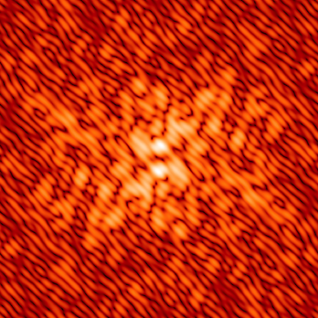
Self-CoherentCamera (SCC) & Multi Reference SCC (MRSCC)
Spatial encoding of the speckles in focal plane :
Estimation of the complex field
Not model dependent
One (MR)SCC image (= science image) per correction loop
Proven Closed-loop correction (at ≈10 Hz) in the lab at 10⁸ contrast with bandwidths (1 to 80 nm in the visible)
SCC = 1 reference pupil
MRSCC = 2 to 3 references

